Slide 1
Development of a Karaoke Application for Language Learning
Mehmet Ali BEKERECİ
Ege Naz ALARSLAN
Tolga KARAMAN
Assist. Prof. Dr. A. Nurdan SARAN

Slide 2
OUTLINE
Problem Statement
Work Plan
Work Done
Used Technologies
Success Criteria
Outputs
Results & Conclusion

Slide 3
PROBLEM STATEMENT
Difficulties in language learning
Karaoke applications are based on matched signals, not words
Songs which exist in karaoke application are not suitable for language learning

Slide 4
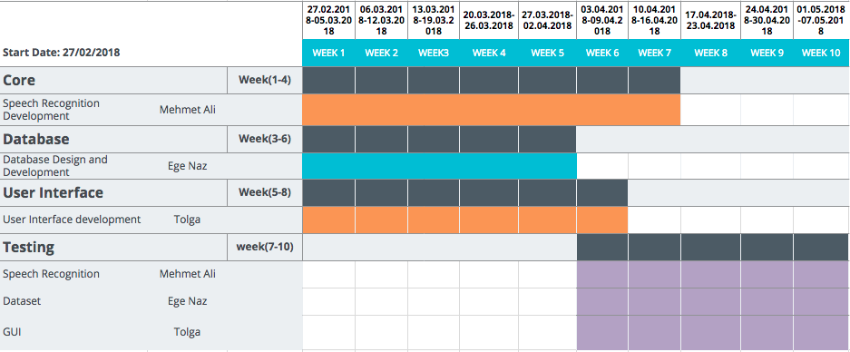
WORK PLAN

Slide 5
WORK DONE
Job Description | Owner
Development of Speech Recognition | Mehmet Ali
Database Design and Development | Ege Naz
Initial GUI Design and Initial Development | Tolga
Re-Design and Re-Development GUI | Mehmet Ali - Ege Naz

Slide 6




USED TECHNOLOGIES
CMU Sphinx

Slide 7
SUCCESS CRITERIA
Success Criteria | Measurement
Improved language learning process on target audience | Analyzing their score histories
Undeniable results of language learning compare to the other tools and materials | Analyzing their overall performance before and after the application

Slide 8
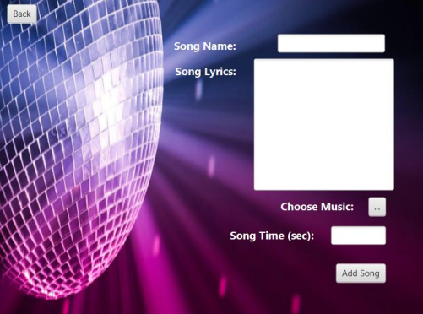
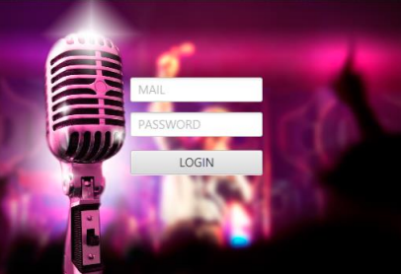
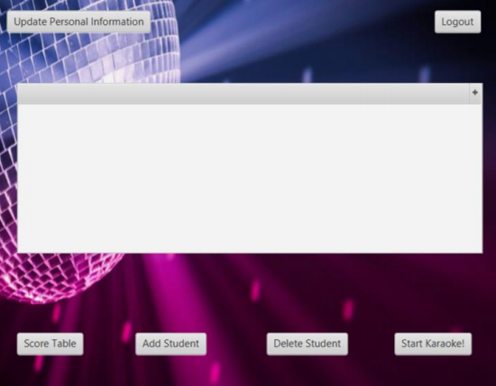
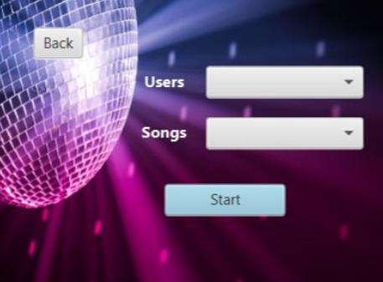
OUTPUTS

Slide 9
RESULT & CONCLUSION
In noisy environment or being incompatible microphone, accuracy rate is %74.
In silent environment or qualified microphone, accuracy rate is %87.

Slide 10
Thank You!

